Slide 1

Academic Session 2025-26
Even Semester Jan-May 2026
UNIVERSITY INSTITUTE OF ENGINEERING
AIT-CSE (AIML)
CS221: B.E. CSE (AIML)
6th Semester
Artificial Intelligence
(23CSH-378)
Unit No. 1 Chapter No. 1 Lecture No. 1 to 5
Topic : Introduction to AI
Dr. Prabhjot Kaur (E16646) Assistant Professor

Slide 2
COURSE OBJECTIVES
1
The course aims to:
To develop an architecture and components of expert systems and distinguish them from conventional programming approaches.
To apply knowledge representation and knowledge acquisition techniques for designing intelligent and rule-based systems.
To explain inference mechanisms and explanation systems used in expert systems for effective decision making.
To understand AI planning approaches, including classical, hierarchical, and multi-agent planning for real-world problem solving.
To explore AI applications in robotics and computer vision, including path planning, obstacle avoidance, object detection, and SLAM using OpenCV.

Slide 3

COURSE OUTCOMES
2
On completion of this course, the students shall be able to:
CO1 | Recall the fundamental concepts of AI, including intelligent agents, problem-solving approaches, and search strategies.
CO2 | Illustrate the various search techniques, including uninformed and heuristic-based methods, to solve AI-related problems.
CO3 | Implement rule-based systems using forward and backward chaining for decision-making and learning.
CO4 | Analyze and evaluate different knowledge representation techniques, logic programming, and reasoning methods in AI.
CO5 | Design and implement uncertainty handling techniques, including probabilistic reasoning, fuzzy logic, and Bayesian networks.

Slide 4
Unit-I Syllabus
3
Unit-1 | Regression | Contact Hours: 15
Introduction to AI | Introduction, AI problems, foundation of AI and history of AI intelligent agents: Agents and Environments, the concept of rationality, the nature of environments, structure of agents, problem solving agents, problem formulation.
Search Strategies in AI | State Space Representation, uniformed search strategies – Breadth first search, depth first Search. Informed Search Strategies (Heuristic search) Hill climbing, A*, AO* Algorithms, Problem reduction, Constraint Satisfaction Problems (CSP)
Game Playing and Adversarial Search | Introduction, Adversarial Search Algorithms: Mini-Max Algorithm, Optimal Strategies for Game Playing, Alpha-Beta Pruning (Optimization of Mini-Max),Move Ordering and Efficiency Improvements, Game Trees and State Representation, Real-World Applications of Game AI
Self-Study | Backtracking, local search, and arc consistency techniques, Designing heuristics for strategic decision-making, Probabilistic decision-making in game AI

Slide 5
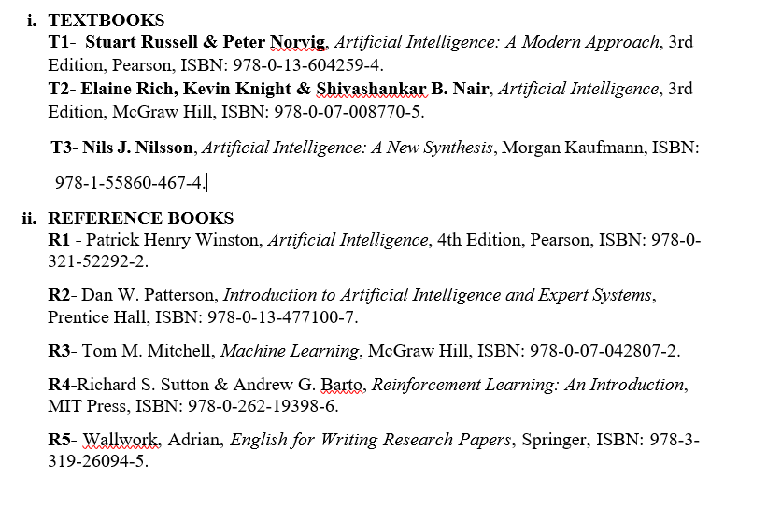
SUGGESTIVE READINGS
4

Slide 6
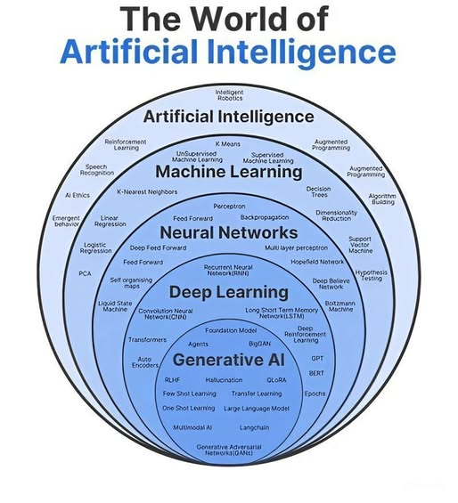
Table of Contents
5
Introduction to AI
Applications of AI
AI Problems - Types
Examples of AI Problems
Foundation of AI
History of AI – Timeline

Slide 7

Introduction:
Artificial Intelligence is composed of two words Artificial and Intelligence, where
Artificial defines "man-made“
Intelligence defines "thinking power"
AI means "a man-made thinking power.“
Artificial intelligence (AI) is both science and engineering.

Slide 8
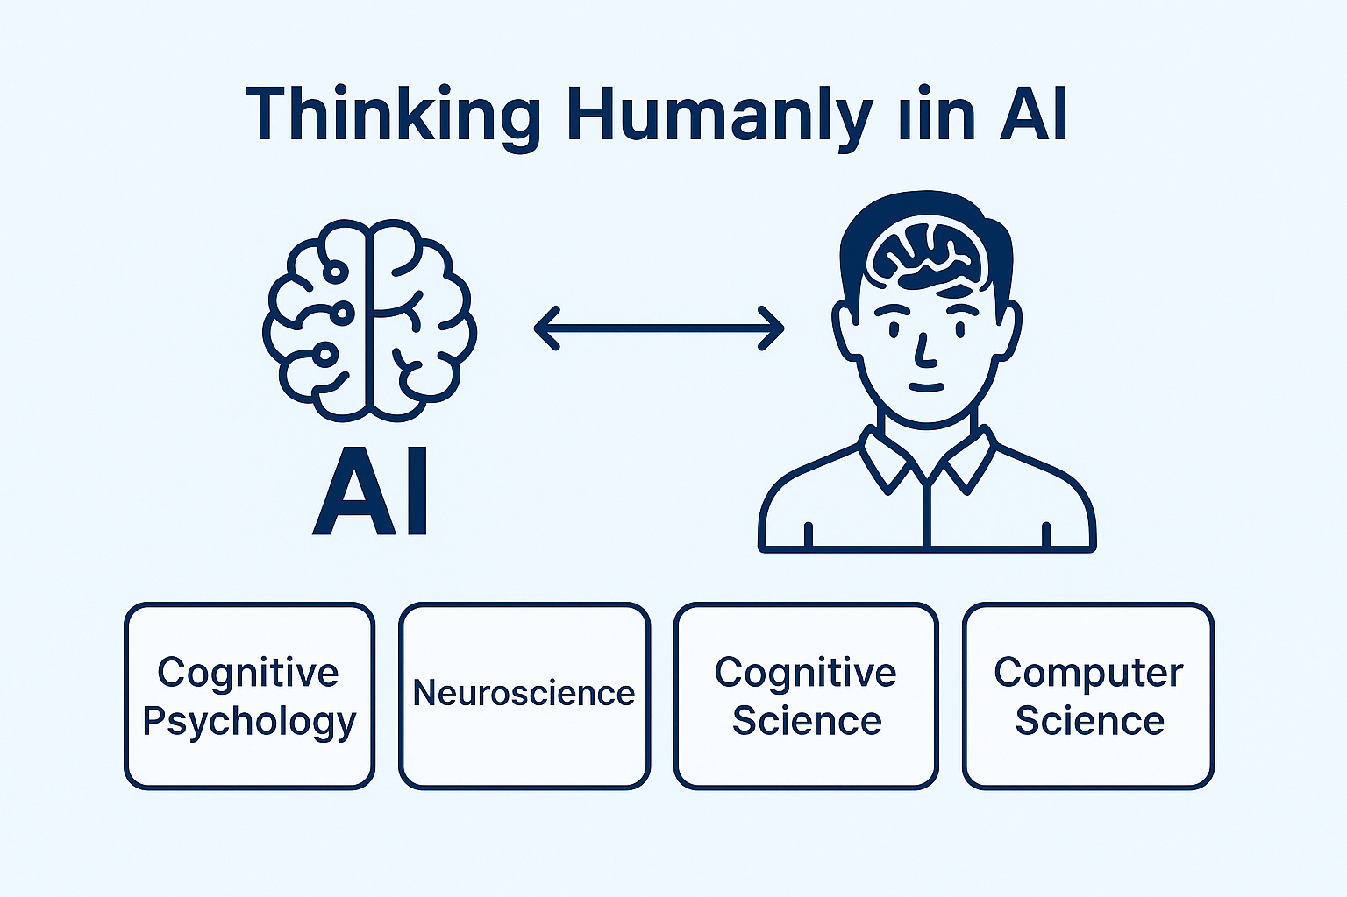
Modelling how humans think.

Slide 9
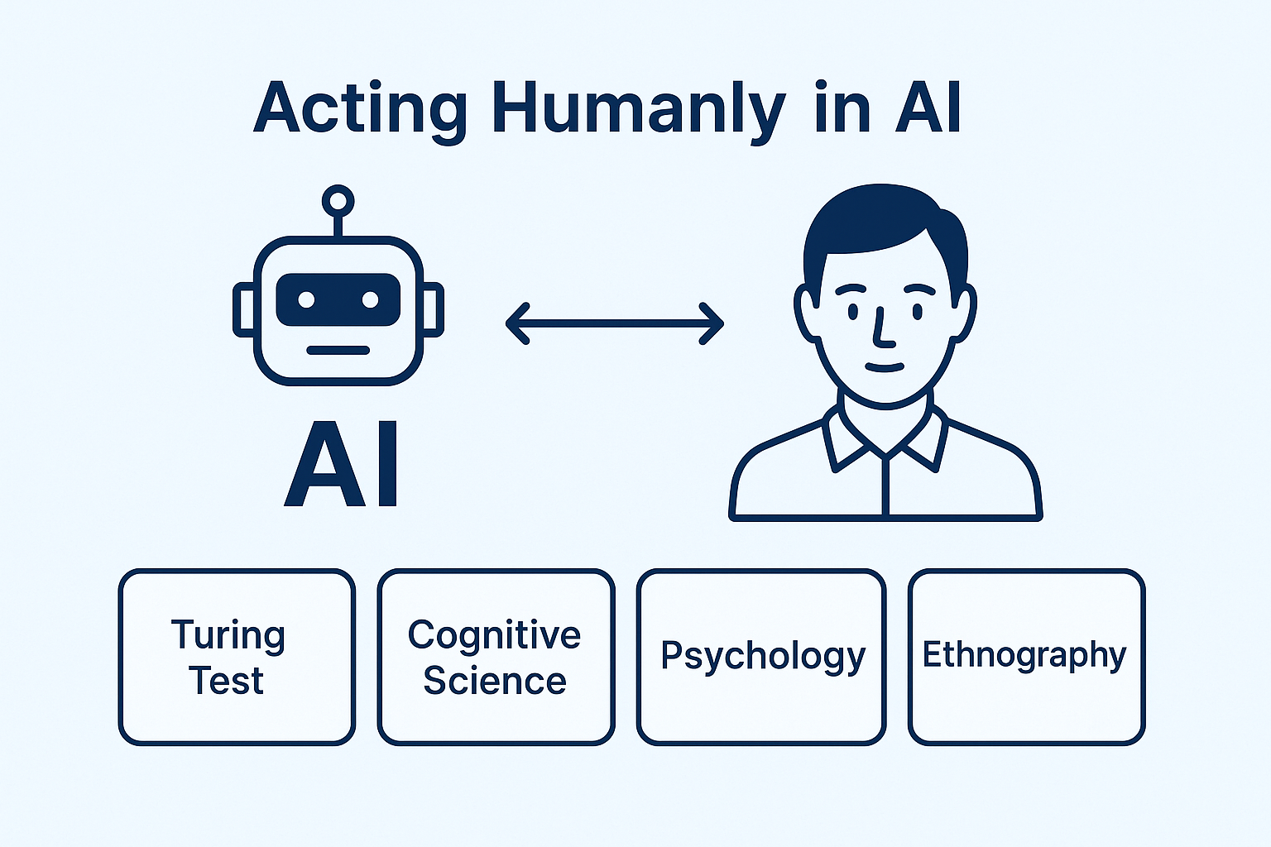
Copying human behaviour

Slide 10
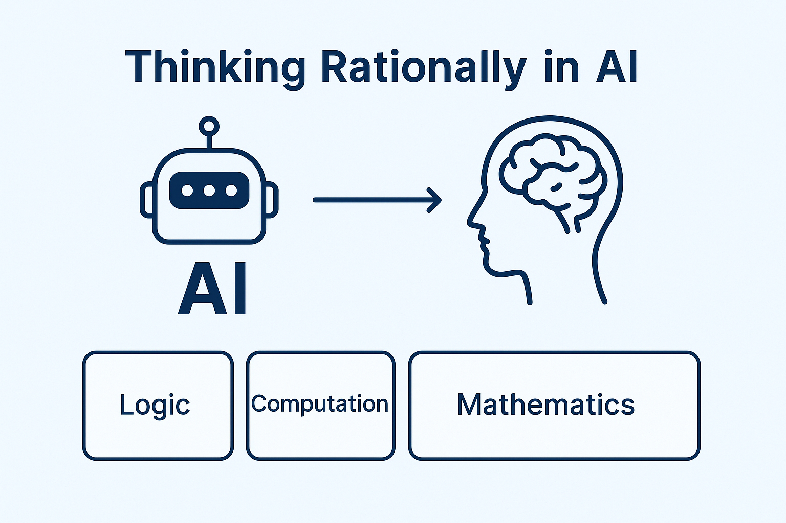
Using logic to think correctly.

Slide 11
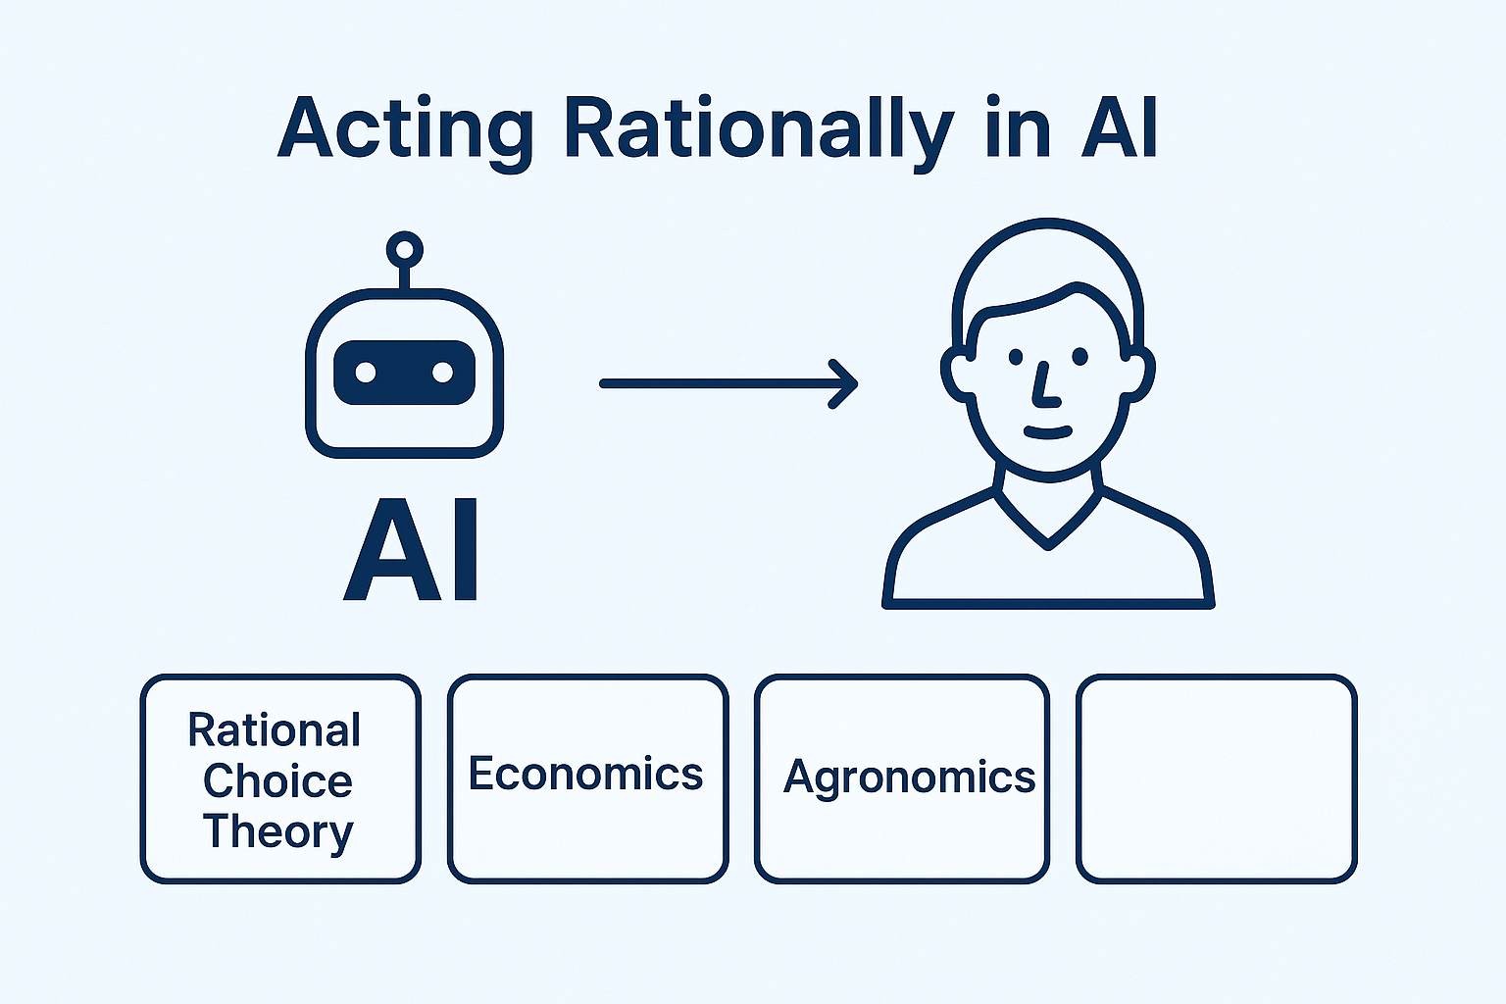
Taking the best possible action.

Slide 12
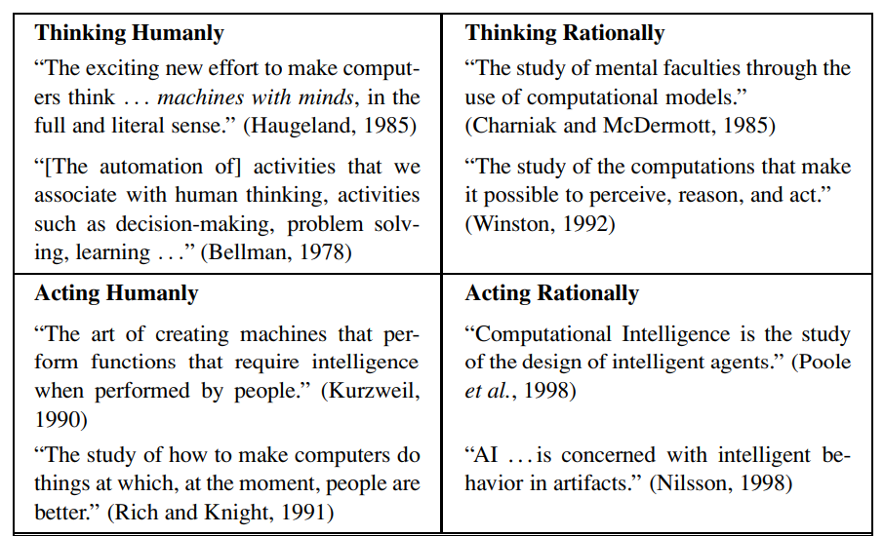
Notes:
Artificial Intelligence is composed of two words Artificial and Intelligence, where Artificial defines "man-made," and intelligence defines "thinking power", hence AI means "a man-made thinking power.“
Artificial Intelligence exists when a machine can have human based skills such as learning, reasoning, and solving problems
Eight definitions of AI, laid out along two dimensions. The definitions on top are concerned with thought processes and reasoning, whereas the ones on the bottom address behavior. The definitions on the left measure success in terms of fidelity to human performance, whereas RATIONALITY the ones on the right measure against an ideal performance measure, called rationality. A system is rational if it does the “right thing,” given what it knows.
THE FOUNDATIONS OF ARTIFICIAL INTELLIGENCE
Philosophy • Can formal rules be used to draw valid conclusions? • How does the mind arise from a physical brain? • Where does knowledge come from? • How does knowledge lead to action?
Mathematics • What are the formal rules to draw valid conclusions? • What can be computed? • How do we reason with uncertain information?
Economics • How should we make decisions so as to maximize payoff? • How should we do this when others may not go along? • How should we do this when the payoff may be far in the future?
Neuroscience • How do brains process information?
Psychology • How do humans and animals think and act?
Computer engineering • How can we build an efficient computer?
Control theory and cybernetics • How can artifacts operate under their own control?
Linguistics • How does language relate to thought?

Slide 13
Artificial Intelligence (AI) is the branch of computer science concerned with building systems that can perform tasks that typically require human intelligence.
Keywords:
Learning
Reasoning
Problem-solving
Perception
Language understanding

Slide 14
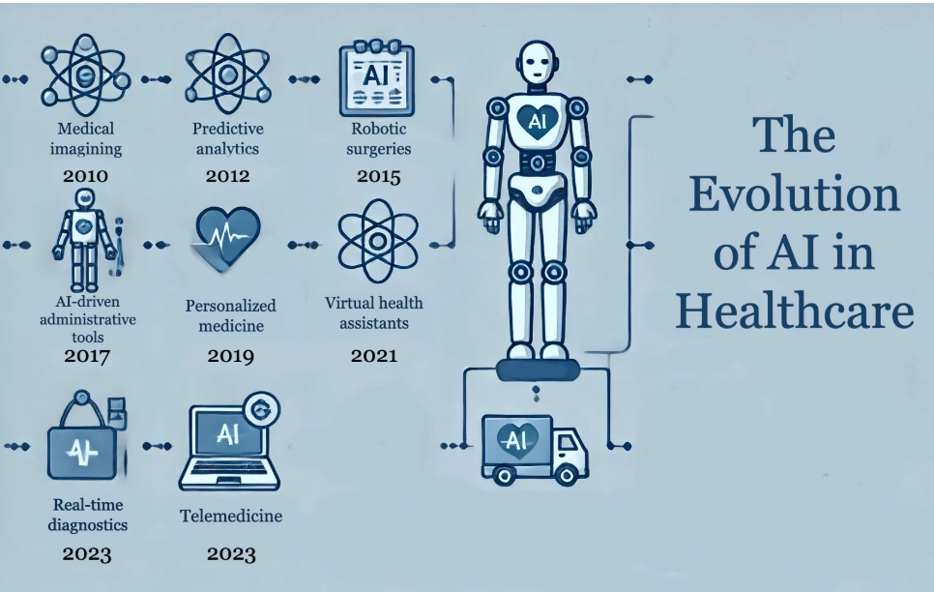
Applications of AI
Healthcare- Disease diagnosis

Slide 15
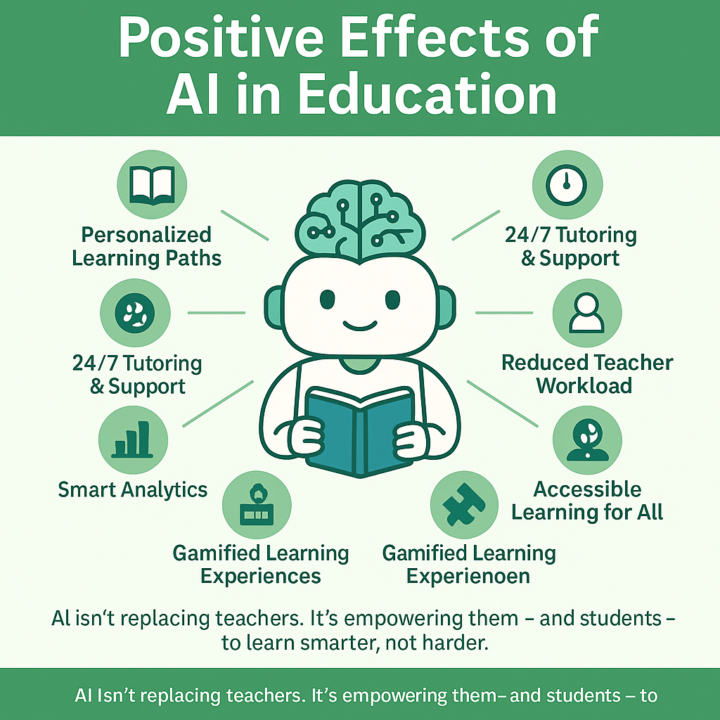
Applications of AI
Education- Intelligent tutoring systems

Slide 16
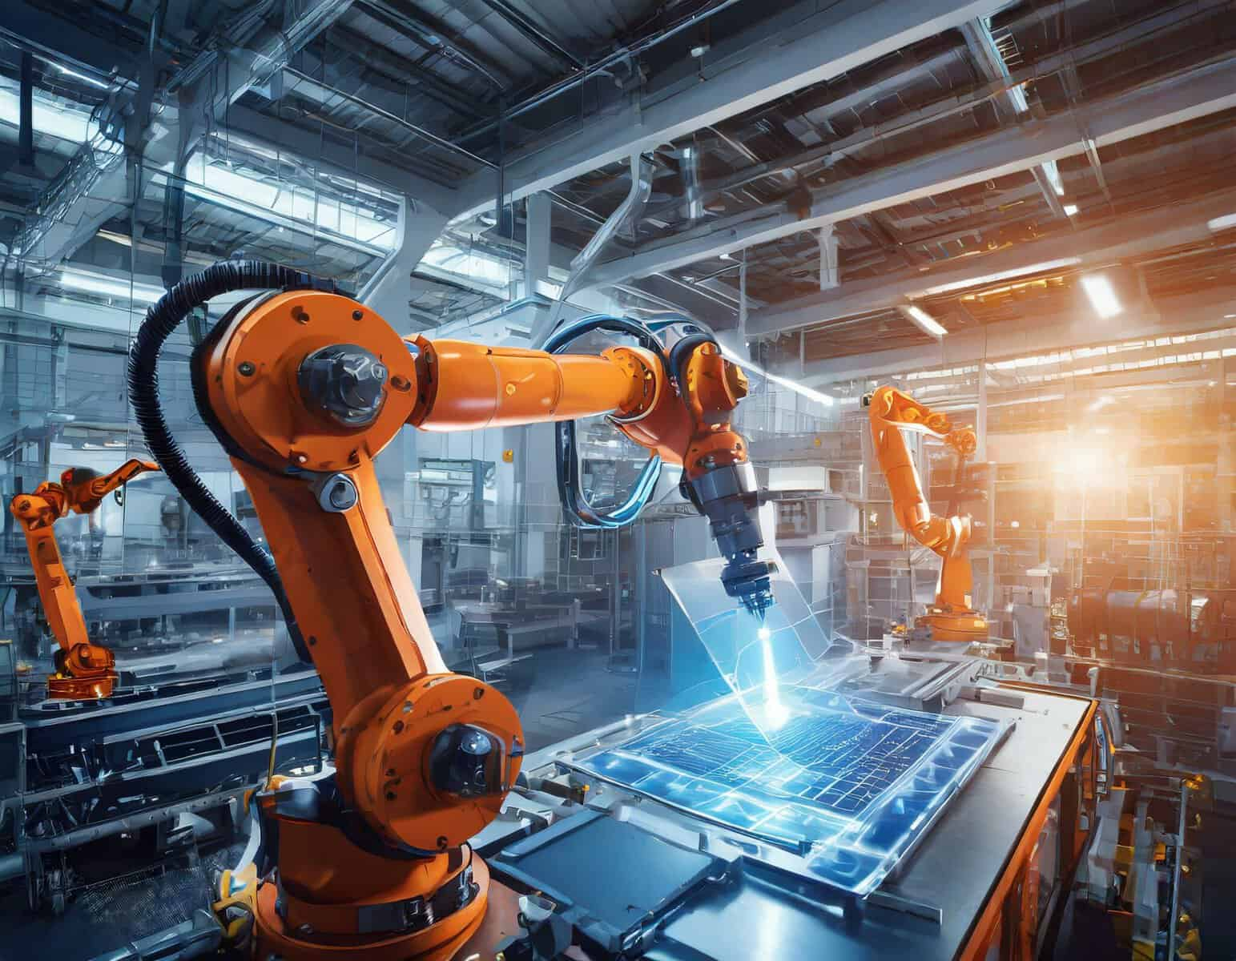
Applications of AI
Industry – Automation and robotics

Slide 17
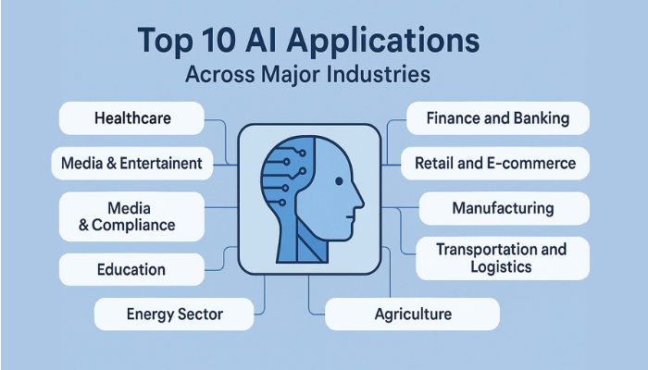
Applications

Slide 18
Artificial Intelligence Problem
Lack of Generalization
Data Privacy and Security
Bias and Fairness Issues
High Computational Costs
Explainability and Transparency
Ethical and Legal Concerns

Slide 19
Foundation of AI
Artificial Intelligence (AI) is built on the convergence of several foundational disciplines. These include:
Philosophy
Mathematics
Computer Science
Psychology & Cognitive Science
Linguistics
Neuroscience
Engineering

Slide 20
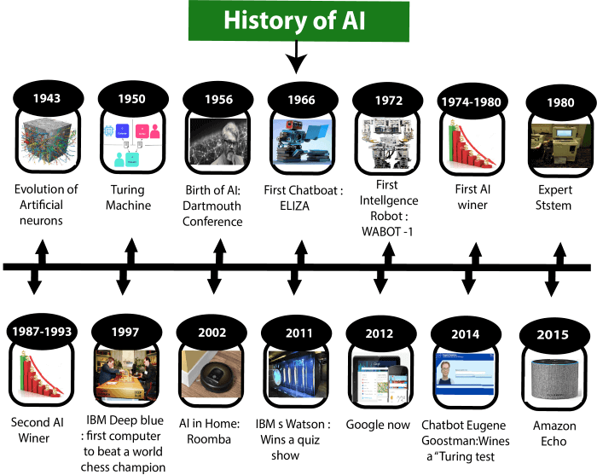

Slide 21
Timeline Highlights:
1950: Alan Turing’s question – "Can machines think?"
1956: Dartmouth Conference — AI as a field was born
1980s–Today: Expert systems, ML, deep learning, robotics

Slide 22
Intelligent Agents – Definition
An agent is an entity that perceives its environment and acts upon it.
Example: Robot, software bot
An AI agent is a software program that perceives its environment, takes autonomous actions to achieve goals, and can improve its performance over time.

Slide 23
Intelligent Agent
Definition: An intelligent agent is an entity that perceives its environment through sensors and acts upon that environment using actuators in a rational manner.
Key Characteristics:
Autonomy
Reactivity
Pro-activeness
Social ability

Slide 24
What AI agents do
Perceive the environment: They gather and process information from their surroundings, which can include text, voice, code, or sensor data.
Reason and plan: They use this information to reason and make decisions, formulating plans to achieve specific goals.
Take action: They can perform actions autonomously, such as making a call, running a query, or generating code.
Adapt and learn: They learn from experience and feedback, adapting their behavior over time to improve their performance.
Use tools: They can use external tools and access systems like the internet, databases, or APIs to complete tasks that require up-to-date or specialized information.

Slide 25
Examples of AI agents
Virtual assistants: Like those on smartphones, which can answer questions, set reminders, and perform other tasks based on your requests.
Customer support agents: An AI that can handle customer inquiries, look up information in internal documents, and provide solutions.
Data agents: Systems that can interpret natural language instructions to automate data-related tasks, such as generating queries or identifying anomalies.
Automated vacuum cleaners: A simple example that uses sensors to perceive its environment and act to clean efficiently.
Software design agents: AI that can help with tasks like code generation, problem-solving, and IT automation.

Slide 26
Components of an Intelligent Agent
Sensors: To perceive the environment
Actuators: To act in the environment
Processor (Agent Function): Decides what action to take
Example:
Robotic Vacuum Cleaner
Sensors: Infrared, Bump Sensors
Actuators: Wheels, Suction Motor

Slide 27
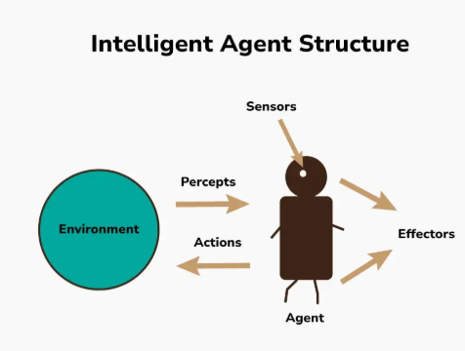
Agent Structure

Slide 28
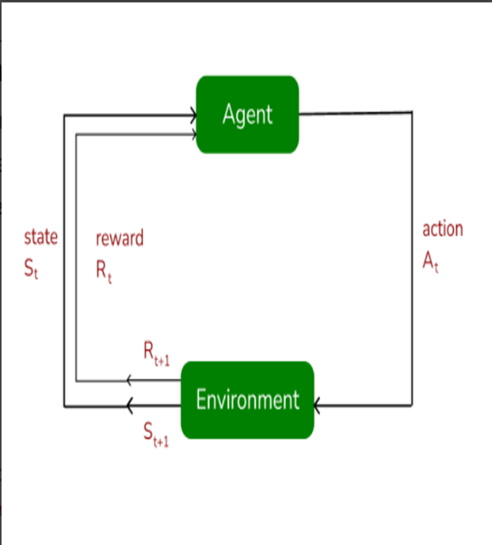
Agents & Environment
Agents: operate in environments ,The agent is said to be the learner or a decision-maker who is capable of interacting with their surroundings to achieve a specific goal.
Environment: Everything external to the agent that the agent interacts with is called the environment. This includes all the conditions, contexts, and dynamics that the agent must respond to.

Slide 29
Environment
Definition: The external world in which an agent operates.
Examples:
A game board for a chess AI
A home for a cleaning robot
The road for a self-driving car

Slide 30
Properties of Environments
Observable vs. Partially Observable: Can the agent fully perceive the environment?
Deterministic vs. Stochastic: Is the next state predictable?
Episodic vs. Sequential: Do past actions affect future actions?
Static vs. Dynamic: Does the environment change while the agent is deciding?
Discrete vs. Continuous: Are the actions and perceptions countable or continuous?

Slide 31
PEAS Framework
P – Performance Measure: Success criteria (e.g., time to complete task)
E – Environment: External conditions (e.g., home, street)
A – Actuators: Tools to act (e.g., wheels, arms)
S – Sensors: Tools to perceive (e.g., cameras, temperature sensors)
Example: Autonomous Taxi
P: Safe and fast transport
E: Roads, traffic, weather
A: Engine, steering, brakes
S: Lidar, GPS, cameras

Slide 32
Concept of Rationality
A rational agent performs actions to achieve best outcome
Based on perception, knowledge and objectives
There are two primary types of rationality in AI: bounded rationality and perfect rationality.
Rationality in AI is a fundamental concept that enables artificial agents to make informed and optimal decisions. By leveraging decision theory, game theory, machine learning, logic, and reinforcement learning, AI systems can achieve varying degrees of rationality.

Slide 33
Types of Agents in AI
Simple Reflex Agents
Model-Based Reflex Agents
Goal-Based Agents
Utility-Based Agents
Learning Agents
Multi-Agent Systems (MAS)
Hierarchical agents

Slide 34
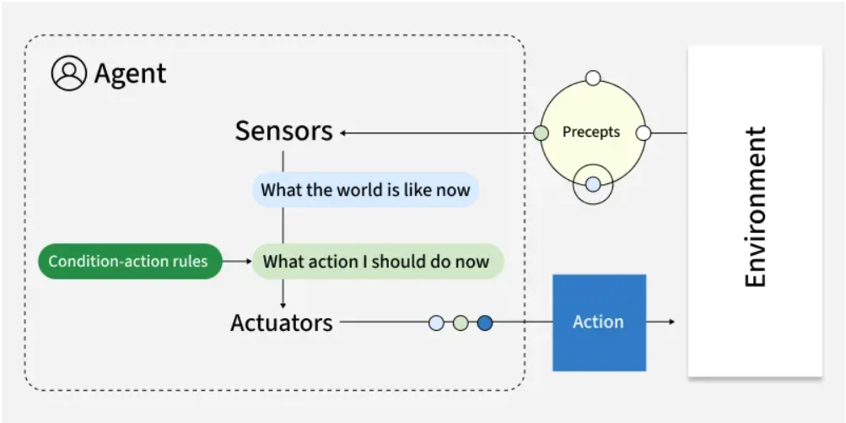
1. Simple Reflex Agents
Simple reflex agents are fundamental constructs in artificial intelligence (AI) that perform on a simple precept.

Slide 35
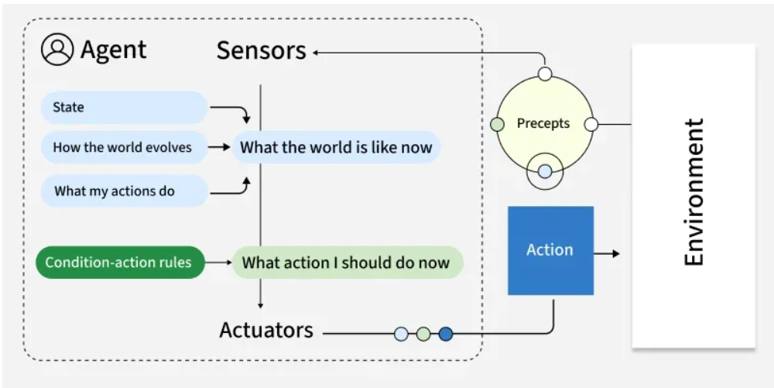
2. Model-Based Reflex Agents
19
Model-based reflex agents are a type of intelligent agent in artificial intelligence that operate on the basis of a simplified model of the world.

Slide 36
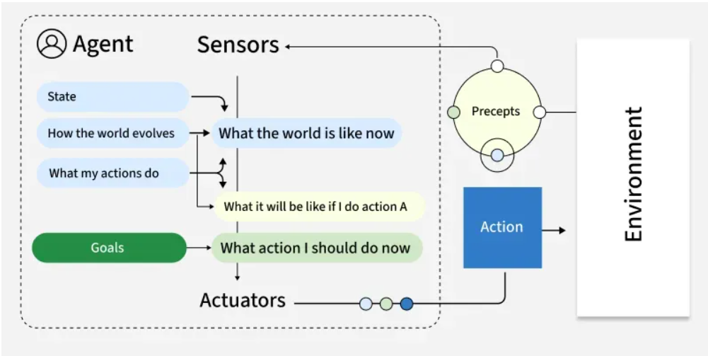
3. Goal-Based Agents
Goal-based agents select actions by considering future states relative to explicit goals. They are capable of planning sequences of actions to reach these goals rather than just reacting to the current state which enables more flexible and intelligent problem-solving.

Slide 37
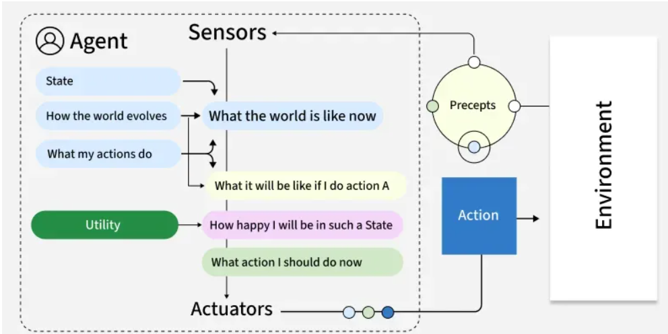
4. Utility-Based Agents
21
Utility-based agents extend goal-based reasoning by considering not only whether a goal is met but also how valuable or desirable a particular outcome is. They use a utility function to quantify preferences and make trade-offs between competing objectives, enabling nuanced decision-making in uncertain or resource-limited situations.

Slide 38
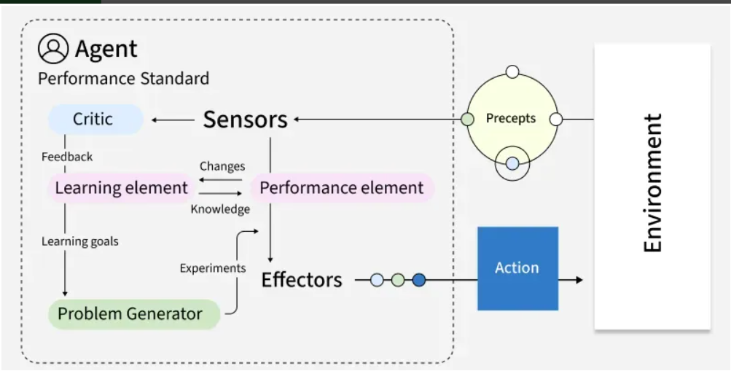
5. Learning Agents
Learning agents improve their performance over time by learning from experience and updating their internal models, strategies or policies.

Slide 39
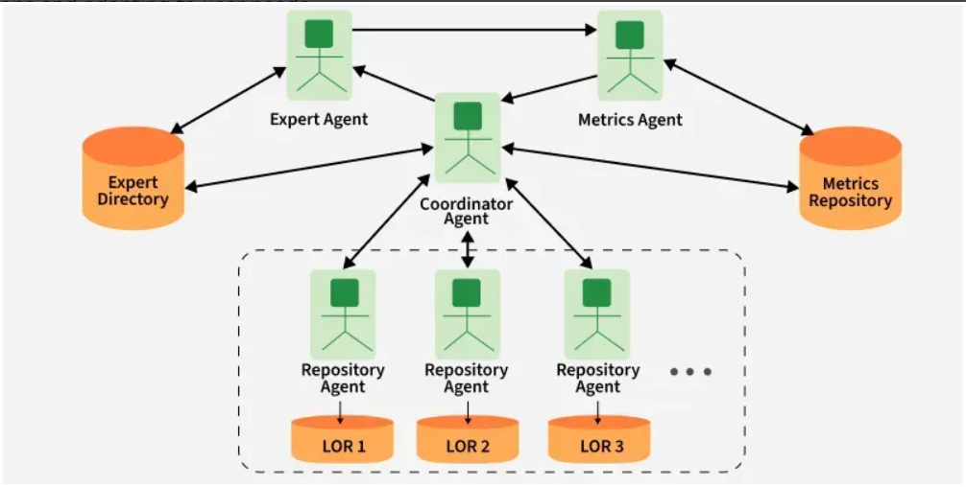
6. Multi-Agent Systems (MAS)
23
Multi-agent systems operate in environments shared with other agents, either cooperating or competing to achieve individual or group goals. These systems are decentralized, often requiring communication, negotiation or coordination protocols.

Slide 40
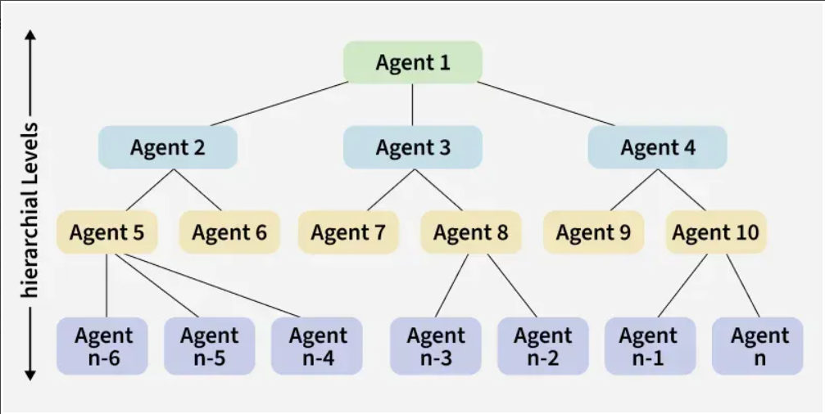
7. Hierarchical agents
Hierarchical agents organize behavior into multiple layers such as strategic, tactical and operational. Higher levels make abstract decisions that break down into more specific subgoals for lower levels to execute.

Slide 41
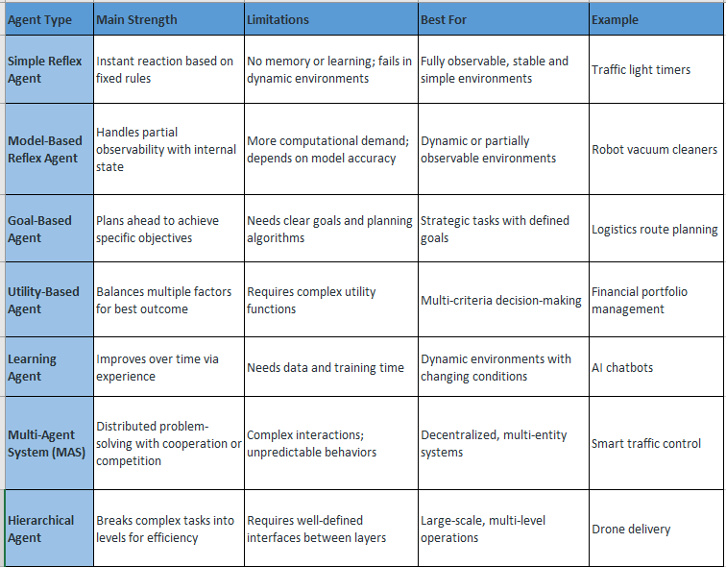
Comparison of AI Agent Types

Slide 42
Problem Formulation
Problem solving is a fundamental concept in artificial intelligence (AI) where systems are designed to identify challenges, make decisions and find efficient solutions.
AI uses agents which are systems that perceive their environment and take actions to achieve specific goals.
They go beyond simple reflex agents which react to stimuli based on pre-defined rules. Instead, problem-solving agents actively analyze situations, evaluate different options and choose the best action to reach their goal.

Slide 43
These agents work by:
Perceiving the environment: They collect data about their surroundings such as sensor inputs or observations.
Defining the problem: They clearly understand the problem including the starting point, the available actions and the desired goal.
Exploring different possibilities: They consider various ways to solve the problem and evaluate which approach is likely to succeed.
Evaluating and deciding: Once they explore options, they assess the outcomes and pick the best course of action based on factors like time, resources and success likelihood.
Learning and adapting: Many problem-solving agents can learn from past experiences, improving their decision-making abilities over time.

Slide 44
Key Components of Problem Formulation
Initial State: This is the starting point of the problem where the AI begins its process. It sets the context and helps identify how the agent will approach the challenge.
Action: At this stage, AI identifies all the possible actions it can take from the initial state. Each action has an impact on how the system moves closer to solving the problem.
Transition: This refers to how the system changes from one state to another after an action is taken. Transition modeling helps show how the agent’s actions influence the next steps.
Goal Test: Once an action is taken, AI checks if it has reached its goal. If the goal is achieved, the problem-solving process stops and the solution is considered complete.
Cost Function: This step assigns a numerical value to the cost of achieving the goal. The cost can include resources like time, energy or money and helps decide the most efficient way to reach the goal.

Slide 45
Summary of the Lecture
39
Artificial Intelligence enables intelligent decision-making.
AI systems solve problems using search and learning.
Intelligent agents interact using sensors and actuators.
Rationality ensures goal-oriented actions. Environment shapes agent behavior.
AI includes learning, reasoning, and perception.
Problem-solving requires proper formulation.
AI combines computer science with human cognition.
AI is widely used in healthcare, robotics, and finance.

Slide 46
Next Lecture
40
In next lecture, we are going to cover:
Search Strategies in AI
Uniformed search strategies
Informed Search Strategies

Slide 47
Quiz/ FAQ’s
41
What do you mean by AI? Discuss its advantages and disadvantages.
Explain 3 main applications of AI in Current era.
Explain the difference between strong AI and weak AI.
Describe the Turing Test and its relevance to AI.
Identify real-world problems that can be solved using AI.
Illustrate how AI differs from conventional programming.
Compare AI with human intelligence in terms of reasoning and learning.
Critique the feasibility of achieving general AI.
Justify the importance of AI in the modern technological world.

Slide 48
Faculty-curated videos, NPTEL, Coursera, LinkedIn, or other relevant learning resources
43
https://nptel.ac.in/courses/106106213
https://www.coursera.org/learn/ai-for-everyone
https://www.coursera.org/learn/introduction-to-ai
https://nptel.ac.in/courses/109106083
https://nptel.ac.in/courses/106105152
https://nptel.ac.in/courses/106105077

Slide 49
9
References/ Videos
Lecture - 1 Introduction to Artificial Intelligence…
An Introduction to Artificial Intelligence - Course

Slide 50

11
Class-Wise Feedback

Slide 51
Thank You
For queries
Email: Prabhjot.e16646@cumail.in

